Slide 1
Ek Gaming Website

Slide 2
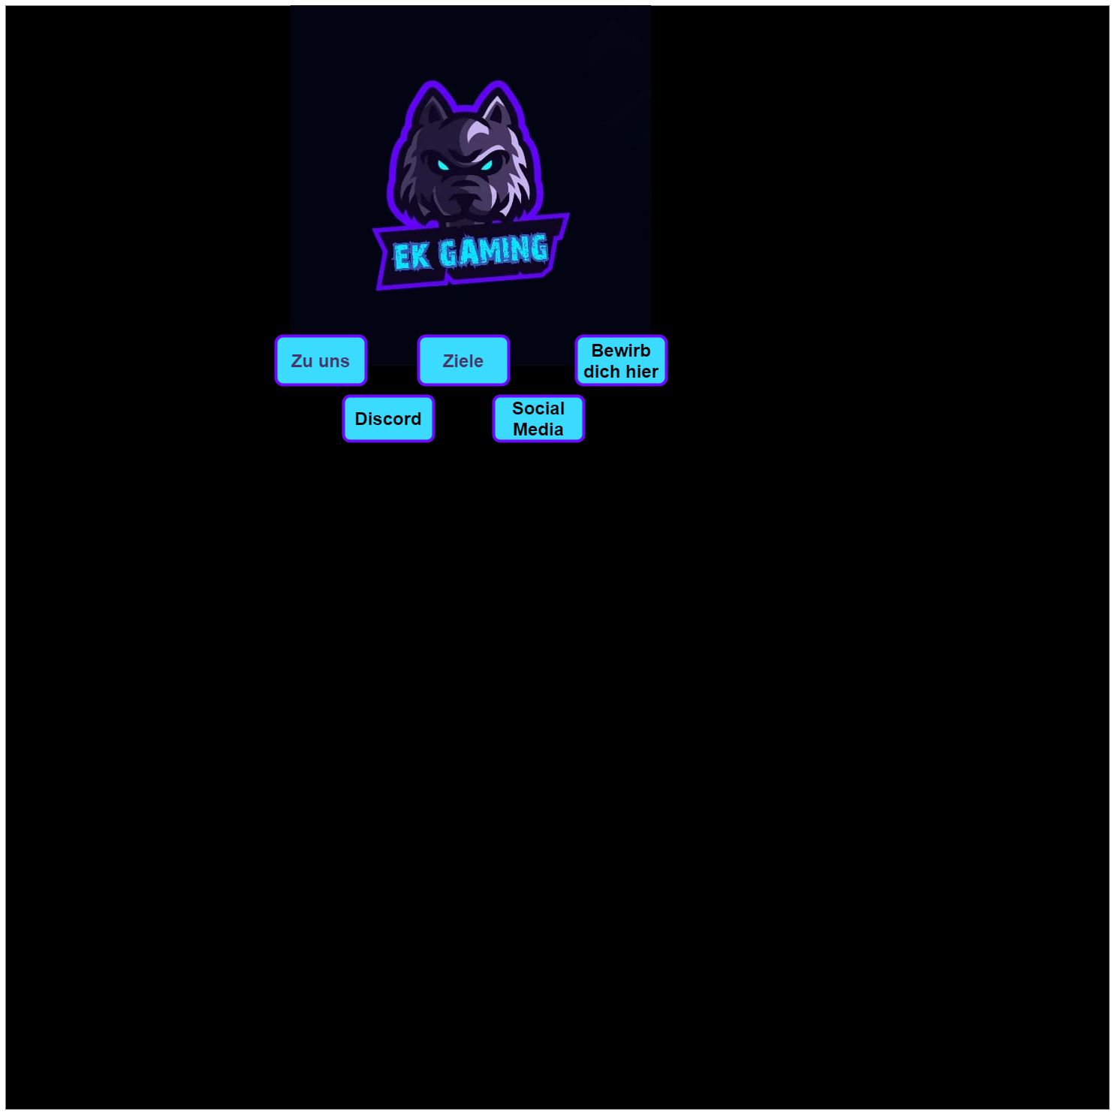


Slide 3



Slide 4



